Slide 1
IDA (Integrated Drainage Architecture):
Sensitized Toxicology Monitoring and Programmed Channelization of Waste Water
Author: Ashirbad Sahu, CSE 2nd Year, Srm University, Kattankulathur, Chennai
Email: ashirbadsahu3@gmail.com, ashirbadsahu_ma@srmuniv.edu.in
Co-Author: Shubham Surana, CSE 2nd Year, Srm University, Kattankulathur, Chennai
Email: shubhamsurana_ra@srmuniv.edu.in
Co-Author: Rishabh Anand, CSE 2nd Year, Srm University, Kattankulathur, Chennai
Email: anand.rishabh1897@gmail.com

Slide 2
Objectives of the Paper
To develop methodologies and present concept of planned sewerage systems and regulate waste water disposal.
To take Liquid Waste, from various architectural pipelining systems to an effective and planned end-result.
To determine the particular algorithms, software incorporations, pathways, modules and compatible retrofitted architecture to make planned drainage management a reality.
To basically define the most improved and compatible waste water management systems available and their effectiveness in handing levels of segregated sewer wastes.
Communication, transmission and positioning modules, microcontrollers and sensor probes to be brought into common grid for developing smart drainage architecture.
Problems as such pose for humankind and need to be solved with innovativeness which makes them reliable for the future, and the requirement lies in their implementation.

Slide 3
REVIEW OF LITERATURE
Existing systems of grid branch pipe-lining.
Conventional drainage architecture.
Short term planning.
Extreme load due to severe population explosion and rapid industrialization.
Failure in layouts due to improper planning and natural calamities.
Rapidly increasing outlets without proportionate increase in pipelining.
Unregulated waste disposal of solids in open drains leading to frequent clogging.
Unplanned proper destination leading to futile disposal attempts.
Unspecified design requirements for wastewater treatment plants.
Lack of targeted delivery mechanism.
Lacking modernization and regulation by modern day computational systems.
Construction, modification and retrofication of the existing systems in use.

Slide 4
RELEVANCE OF THE STUDY
Target Sewers and Drains already built to sustain an exponential rise of population over a period of valid expansions.
To make this drainage network self –reliant, regulation, smart and controlled.
Immediate address to problem and going into steps of actions with targeted goals to smoother the channelized sewage .
Unleashing newer dimensions with a precise end location for every discharge in drains and evaluated on basis of the IDA modules

Slide 5
Research Methodology
The basic data that has been proposed is on the basis of available or upcoming feasible technology.
The graphical and tabular representations is of secondary data collected and has been analysed to be applicable in this context.
The sewerage network maps and real time images have been taken from reliable archives, fact books that depict the present scenario.
Live experience of the researchers with sufferings caused nationwide instigated the thought and approach towards such a project paper.
This ensures a reliable implementation of various available pieces of technology under modular effectively usable components.
This brings diverse pieces of technology under an umbrella project to perform in sync, liquid waste management and warning operations.

Slide 6
INTRODUCTION
Addressing solutions to menace created by present existing drainage network in urban areas.
Solutions to unplanned structure resulting in complete ineffectiveness of liquid waste management.
Overflow and complete system failure in case of minor natural calamities, frequent clogging of drains in cities.
The severity being taken into consideration of posed health hazards due to no end planning .
Need of some immediate technological overhaul that can be retrofitted with the existing systems.
It works on the key Principle of:
(STD² ):
Safely-Simplify and Segregate,
Track and Transport,
Detoxify and Dispose
Forms part of network for safe liquid waste disposal.

Slide 7
Safely-Simplify and Segregate
Details of Database to be incorporated:
IRNSS coordinate data for Indian bound systems, for i.e. Manhole /Starting/ Junction Location.
Leakage detection and Overflow alert
Density of flux in motion per cross sectional area of drain outlet.
Threshold indication for excessive Biological tissues causing enrichment.
Non-Biodegradable scum abstraction level.
Heavy metal presence or absence with toxicity index.
Radioactive waste if any (Geiger absorbing-scope)measuring leakages or emission and alert to systems if even in trace quantities
Backflow prevention Checkgate
Minimizing human interaction with devices and only periodic checking as per requirement.
Interfaces are executed in modular hierarchy.
Monitoring present flow, density and maximum capacity per cross section in sewers.

Slide 8
Tracking and Transport
Simplification of data obtained and parameter limits for regulation and exceptions are set.
Functioning is on the basis of segregation that divides Types and Phases of liquid waste and assign it a level.
Targeted delivery of wastage to categorized wastewater treatment facilities.
Tracking Modules initiated with GAGAN and IRNSS.
Address cleaning, blockage or clogging problems immediately.
Data relay modules for near field and cloud uploads.

Slide 9
Detoxify and Dispose
Detoxification based on pollutants and requisite reagents to neutralize action up to the extent possible.
Action against violation of secure biological tissue density for sewers line originating from medical facilities.
Heavy metallic influx to be settled and later phased meet before allowing to enter intermediate stages of treatment.
Carcinogenic components enriching water with Arsenic, enriching, etc. as well as Corrosive reagents to be avoided from entering channel to extent possible.
Regulated flow with check valves using standardized RCC and Aluminum gates.
Reagents Used:
Sodium Sulphide action
Hydrogen Peroxide bleaching
Inner Crest removed by peroxide forced backflow by methods used in boilers.

Slide 10
Theory
Waste water is the water that emerges after fresh water is used by human beings for domestic, commercial and industrial use.
Grey water is that water which emerges after these uses contains, vegetable matter, oils used in cooking, oil in hair, detergents, dirt from floors that have been washed , soap used in bathing along with oils/greases.
Water used to flush toilets to evacuate human excreta is called “Black Water” or Sewage.
Water pollution can be caused by pathogens, inorganic compounds, organic material and macroscopic pollutants.
Carcinogens Pollutants
Inorganic materials:
Organic Materials:
Macroscopic Pollution:
Wastewater Treatment Plan:
Reagents and Chemicals-
Existing purification standards-
Organic Materials:
Adsorption/Filtration

Slide 11
Disinfectants kill present microorganisms in the water. There are various different types of disinfectants: · Chlorine · Chlorine dioxide · Ozone · Hypochlorite
REAGENTS AND CHEMICALS
For the chemical treatment of water a great variety of chemicals can be applied. Below, the different types of water treatment chemicals are summarized up:
Antifoams Coagulants Corrosion inhibitors Disinfectants
Emulsions Neutralizing agents Oxidants Oxygen scavengers pH conditioners Scale inhibitors
Algaecides
Different kinds of corrosion inhibitors Includes:
Passivity inhibitors:
Cathodic inhibitors
Organic inhibitors
Precipitation inducing inhibitors.
Volatile Corrosion Inhibitors (VCI).

Slide 12
Methods and Sensors
FILTERPOD
FALCON
VORTEX
RBC
BIOCUBE
1) Manti Lab MT-120 Digital Dissolved Oxygen Meter, DO Concentration Mode: 0 - 20 ppm (Initial Test)
2) Libelium – It based on Smart Water wireless sensor platform
The Inter-integrated Circuit (I2C)
Waspmote
DBMS-Database Management Systems
NFC-Near Field Communication
Cloud Computing
Blade Servers
Arkbird Receivers

Slide 13
CONTAMINANTS AND COMPOSITION OF DRAINAGE WATER:
The inorganic material that are soluble such as ammonia, road -salt, sea-salt, cyanide, hydrogen Sulphide, thiocyanates and thiosulfates and etc.
Animals such as protozoa, insects, arthropods, small fish, etc.
Macro- solids such as sanitary napkins, nappies, condoms, needle children’s toys, dead animals or plants etc.
Gases such as hydrogen sulfide, carbon dioxide, methane etc.
Emulsions as paints, adhesives, mayonnaise, hair colorants, emulsified oils etc.
Toxins such as pesticide, poisons, herbicides, etc.
Pharmaceuticals and hormones.

Slide 14
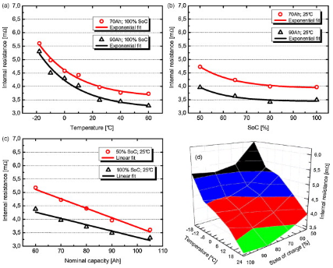
Power/battery:
Waterproof Lithium-Air Batteries:
Use of lightweight, high-energy batteries that can use the surrounding air as a cathode. Under development is single-use lithium metal-air batteries with rechargeable lithium metal-air batteries that can go for longer in between charges for around years.
Water power: The prototype battery uses lithium metal as the anode and salt water as the cathode to power on an LED. As the battery discharges, lithium ions start diffuse into the water, but the device doesn’t affect the surrounding habitat.
Lithium-metal batteries try to approach the energy density of fuel cells without having the plumbing required for these devices; in theory and the maximum energy density is more than 5,000 watt-hours per kilogram, or more than 10 times that of present lithium-ion batteries. Lithium metal-air batteries are also very light-weighted because it’s not need to carry a second reactant. Exposure to even traces of water rapidly degrades the material strength.
BATTERIES (Waterproof and submersible if required):

Slide 15
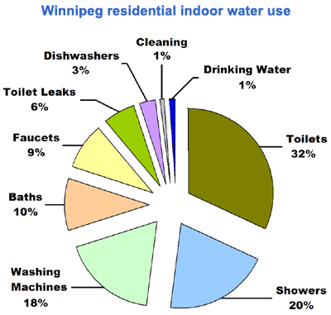
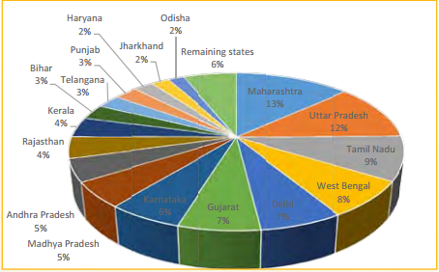
TABLES AND GRAPHS
State wise percentage generation

Slide 16
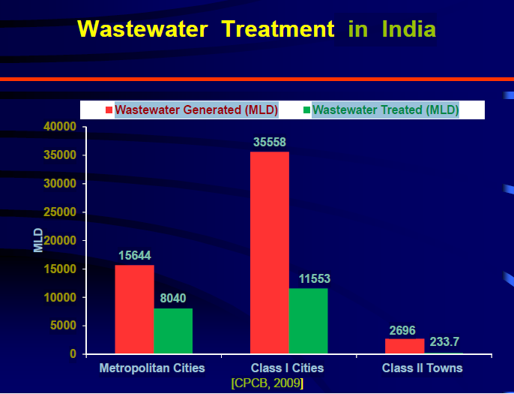
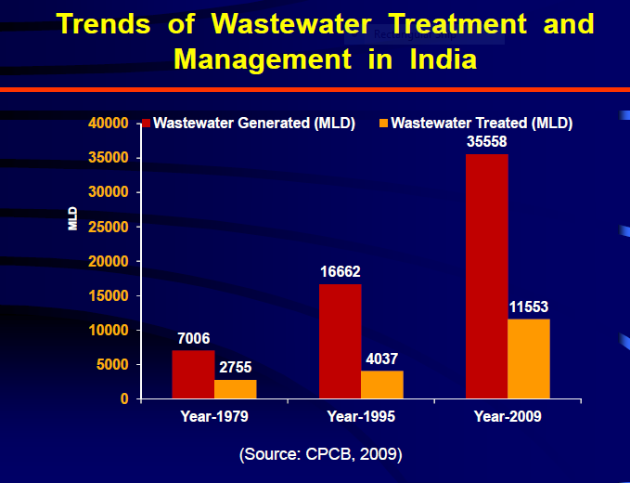
TABLES AND GRAPHS

Slide 17
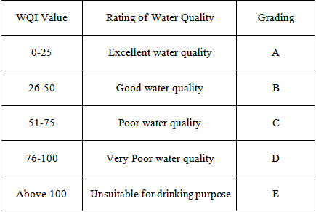
Water Quality Index calculation:
First select finite number of parameters and monitor water quality against the parameters.
2. Develop transformation function/curves and use them to transform the monitored values into Environment.
3. Assign relative importance values to the parameters and obtain weight values to the parameters.
4. Aggregate the parameter values -
a. Take a) sum or b) average or c) geometric mean or combination of these.
b. Or use maximum operator or minimum operator.
Obtain sub-indices and aggregate the sub -indices into WOI.

Slide 18
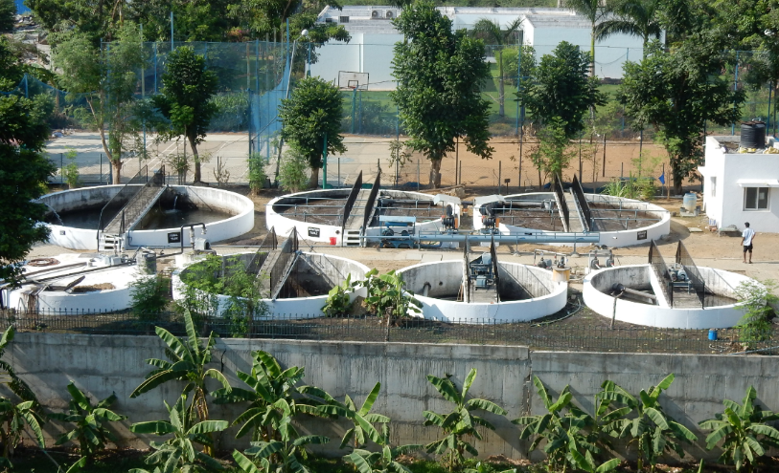
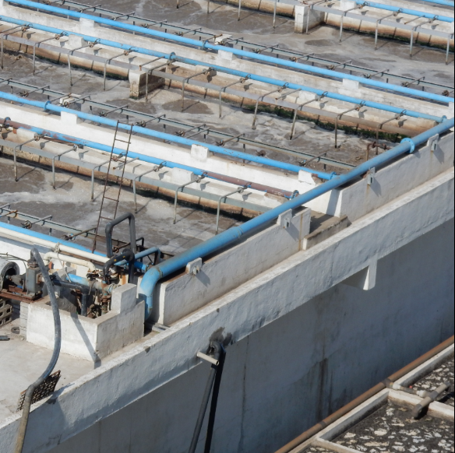
LOCALIZED CASE STUDIES 1: Case 1:
Coming to the point of focus is based a sewage treatment system with a capacity to handle continuous load of 2 lakh individuals established at outskirts that presently handles a capacity of around 80000 individuals with proper sewage treatment facilities with infixed systems and parameters treating water to the best standards possible before release into the nearby lake under proximity.
The catch: Medical College of same university and Machination labs with discarded contaminated human waste and heavy metals lead their daring to the same ponds and then the villagers around nearby locations with residents over 1 lakh have their untreated wastes partially disposed into same lake even after presence of some municipal aid.
Productivity parameters of noble efforts by university being affected in negative ways as resultant tends to:
Mixed unaddressed contaminations.
Resupply of same water after partial treatment from these lakes for certain activities.
Available Facilities not being used to their optimal levels.

Slide 19
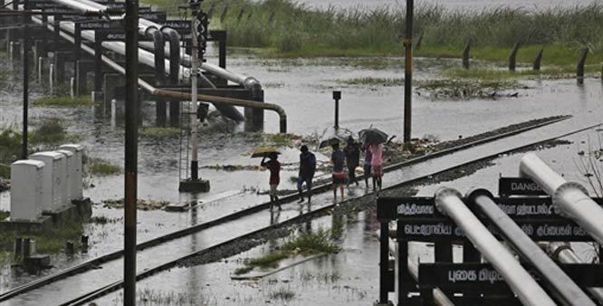
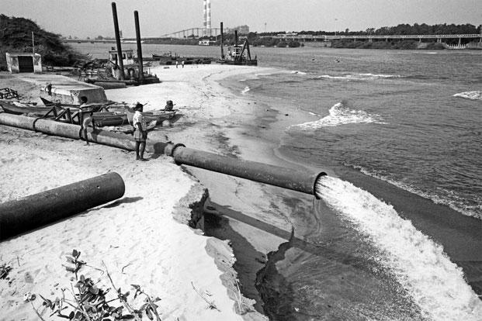
LOCALIZED CASE STUDIES 2:
Broader concern to mega cities considering mis-management rather lack of technology and system coordination regarding recently conducted Chennai Floods.
The city, which witnesses that flooding in some localities was completely marooned. Schools and colleges were remain closed down for two weeks as civic authorities struggled with the flood waters. A population of more than one crore living in the greater Chennai metropolitan area suffered.
Partial aversion could have been possible with proper drainage facility planning with heavy discharge possibilities.
During the floods, when people walked on the roads, they were hit by a rapid influx of water, which does not happen with rain water alone.
The Chennai flood assessment should have been done, For cities prone to disasters like floods, effective disaster response teams and adequate drainage systems is must. Proper urban planning also needs to be done to avoid another disaster similar to that of the Chennai rains.

Slide 20
END Devices:
Modules forming integral branch Of IDA as showcased in the next Slides:
Sensory Grid Checkgate(SGC):
Manhole Monitoring Array(MMA):
Drainage Choke Alert System(DCAS):
Anti-Contamination Warning(ACW):
Final Release Purity Index(FRPI):
Further is detailed the impacts, manufacturing design and working of proposed modules

Slide 21
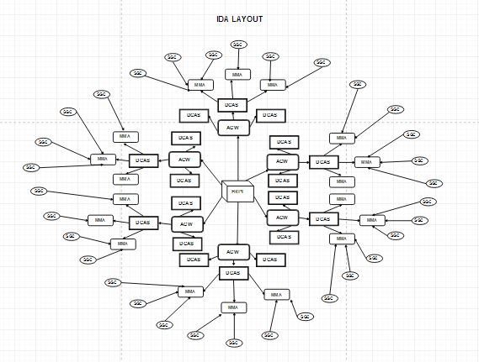
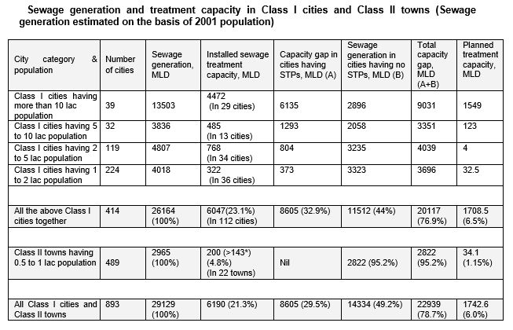
BLUEPRINT OF SYSTEM DESIGN-IDA

Slide 22
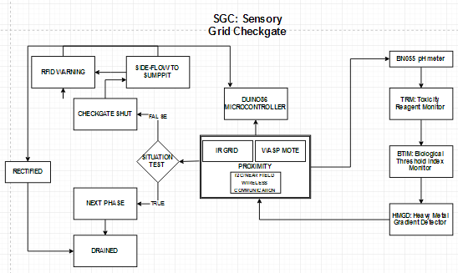
SGC : Sensory Grid Checkgate
Sequence Control Flow:
STAGE 1

Slide 23
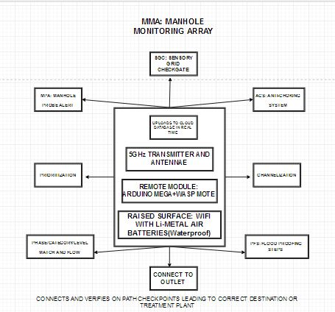
MMA : Manhole Monitoring Array
Sequence Control Flow:
Stage 2

Slide 24
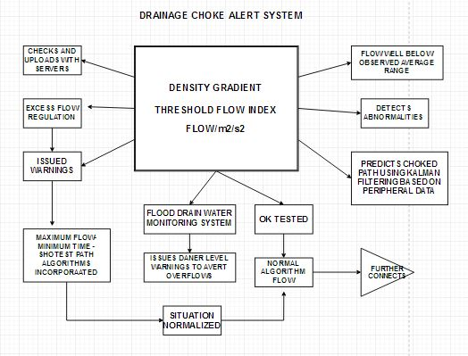
Drainage Choke Alert System
Sequence Control Flow:
Stage 3

Slide 25
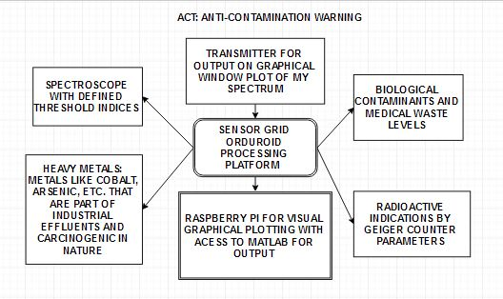
ACT :Anti-Contamination Warning
Submodule present before water from connecting drain reaches stage 1(level category) water treatment plant /facility.
Sequence Control Flow:
Stage 4

Slide 26
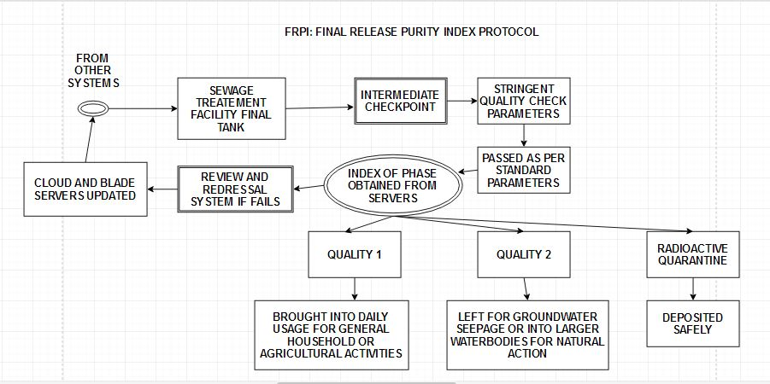
FRPI :Final Release Purity Index
Standards set by PWD department Indian Standards Water index final rechargeable parity index and in terms with WHO parameters as input and regulations.
Protocols based on which standards of other four modules are design and specified.
Sequence Control Flow:
Stage 5

Slide 27
Wastewater Post Treatment Characterization:
Define and State Categories:
Category 1:
Back into direct human usage system (bathing, agriculture, washing, etc.)
Category 2:
Post treatment water from certain facilities that need to be discharged into suitable water bodies for suitable natural actions and actions such as groundwater table recharge action, natural percolation, natural aging, aerobic decomposition and water senescence in lakes and other such facilities.
Category 3:
Wastewater containing high amounts of bodily fluids, biological wastes, medical discharge, communicable contaminants, etc. needing specialized biological reagent treatments or quarantine if necessary.
Category 4:
Heavy water, Arsenic, cobalt Rich, with other heavy metals and absurd industrial pollutants along with hard water or heavy water discharge from coolant facilities in nuclear power Plants that may be exposed and may contain harmful levels of radiations and needs isolation from human establishments.
Category 5:
Absolute Toxins and Poison discharges, and immediately requiring far off safe quarantine from reachable facilities with non-human surveillance mechanisms and strictly kept confidential information about such sites to prevent intentional misuse , accidental leakages, ground leaching or curiosity driven explorations.

Slide 28
Cost Calculation Factors
It depend on the Cost of modules used:
SGC’s
Households: 2500 per module (paid by customers who has to follow prescribed standards during internal drainage construction once + maintenance)
Extra Piping + added architecture: 12 lakhs (interacting +channeling)
MMA +DCAS-10000 per module per square kilometer, to be built on a phase by basis.
ACW +FRPI+ Specialized water treatment plants –
City: 15 crores*3 =50 crores
(Planned on 10 year basis)
Total average cost per block /year - 20 lakhs.

Slide 29
SCOPES OF FURTHER RESEARCH
As time progress, size of IC’s and microcontrollers decrease, increase in computational power.
Simpler modules for effective implementation.
Innovation, advancements, technology targeted improvements in sewage treatment plants.
Reagents to be available as replenishable modules for toxicity neutralization at site of origin.
Developments regarding radioactive confinement against radiation contamination.
Pre-planned layout for upcoming cities, towns and other civics establishments.

Slide 30
Findings Of the Study and Conclusion
Unplanned Proliferations/Expansions bring about newer dimensions into liquid waste managements, sewer maintenance, segregation of wastes.
All must be addressed, treated safe sludge used as manure, optional utilization of sewage treatment plant facilities .
Preventing a nearby lake from getting degraded, making better quality of freshwater available acknowledging its importance in present scenario by utilizing available technology.
Saving water and putting them into secure and proper utilization in all frames, aims towards a green and sustainable future.

Slide 31
BIBLIOGRAPHY AND REFERENCES
https://dnr.mo.gov/education/bigriver/the-water-use-cycle/how-bacteria-eat-waste-generic.pdf
http://www.indiawaterportal.org/questions/frequently-asked-questions-faq-wastewater-sewage-treatment-plants-stp#operatingcoststp
http://www.nsf.org/consumer-resources/health-and-safety-tips/water-quality-treatment-tips/standards-for-water-treatment-systems
http://www.globalspec.com/reference/44200/203279/physical-methods-of-wastewater-treatment
http://www.usalco.com/products/aluminum-sulfate-solution-alum/
http://www.chemtreat.com/solutions/chemical-treatment-programs/wastewater-chemicals/
https://www.gfschemicals.com/statics/documents/technical/technicalc6916e79adc84b238a7bd76254ea0118.html
https://www.spectrumchemical.com/OA_HTML/Equipment_Meters-Testers_Water-Wastewater.jsp?minisite=10020&respid=22372
http://sciencing.com/list-water-pollutants-6309497.html
https://i0.wp.com/fairbd.net/wp-content/uploads/2015/03/Water-Pollution-Of-Most-Of-The-Water-Sources-In-Bangladesh-1.jpg
http://ec.europa.eu/eurostat/statistics-explained/index.php/Water_supply,_sewerage,_waste_management_and_remediation_statistics_-_NACE_Rev._2
http://www.un.org/waterforlifedecade/food_security.shtml
http://www.lenntech.com/wwtp/calculate-daily-sludge-production.htm
http://www.solutionsforwater.org/solutions/wastewater-treatment-integrated-management
http://www.green.aurovilleportal.org/agro/152-integrated-waste-water-treatment
https://www.researchgate.net/figure/261851441_fig2_Figure-2-Integrated-wastewater-treatment-and-sustainable-land-management-in-biomass
https://link.springer.com/chapter/10.1007/978-3-540-74492-4_3
http://betterthesis.dk/getting-started/short-synopsis
http://www.erm.ecs.soton.ac.uk/theme4/aims_and_objectives.html
https://medium.com/the-mission/career-advice-no-one-tells-you-8be1bcd330cb#.wapaw2i01
https://ideascale.com/10-qualities-of-great-innovators/
http://smartstorming.com/what-makes-a-good-idea-good
http://www.izito.co.in/ws?q=school%20science%20project%20ideas&asid=iz_in_gb_2_cg1_08&mt=b&nw=g&de=c&ap=1t1
http://www.skylineswiki.com/Water_and_sewage#Pipes
http://www.museumofthecity.org/project/a-brief-history-of-urban-waste-management/
http://www.skylineswiki.com/Water_and_sewage
https://www.alexandriava.gov/Sewers
http://www.louisvillewater.com/leadservices
http://www.agriinfo.in/default.aspx?page=topic&superid=7&topicid=38
http://www.ulmaarchitectural.com/en/drainage-channels/
http://www.mea-group.com/en/drainage-systems
http://www.cwejournal.org/vol8no3/assessment-of-groundwater-quality-in-saltaua-gopalpur-block-of-basti-district-u-p-india/
http://healingearth.ijep.net/water/case-study-river-ganges
http://nmcg.nic.in/
http://www.shanghai.gov.cn/shanghai/node27118/n31193/n31212/u22ai71924.html
https://www.omicsonline.org/open-access/water-quality-assessment-in-terms-of-water-quality-index-wqi-usinggis-in-ballia-district-uttar-pradesh-india-2161-0525-1000366.php?aid=73831
https://archive.epa.gov/water/archive/web/html/index-19.html
http://bcn.boulder.co.us/basin/watershed/wqi_info.html
http://www.sciencedirect.com/science/article/pii/S0160412014000944
https://www.ideals.illinois.edu/handle/2142/49457
http://fairbd.net/water-pollution-of-most-of-the-water-sources-in-bangladesh/
http://www.libelium.com/development/waspmote/documentation/smart-water-ions-board-technical-guide/
https://www.agridrain.com/shop/c91/check-valves-6-12/p109/12-pvc-check-valve/
http://www.balkanplumbing.com/sewer-services-water-main-services/sewer-check-valves-backwater-check-valves/
http://watermanusa.com/products/drainage-gates/af-41-flap-gates/
https://i.ytimg.com/vi/FMBznnNV-ss/maxresdefault.jpg
http://www.precisionsewage.com.my/wp-content/uploads/2014/07/29062012903.jpg
https://static1.squarespace.com/static/51b43fb3e4b0f0ee887bb130/t/565853f1e4b04cd6ce89b138/1448629234665/checkmate-valve-closed
http://commercialplumbingsupply.com/prodimages/jslarge/67360_large.jpg
http://backwatervalve.com/Upload/products/adapt-a-valve/adapt-a-valve-with-text.jpg
http://www.lenntech.com/products/chemicals/water-treatment-chemicals.htm

Slide 32
THANK YOU

